Slide 1


Department of Computer Science and Engineering
GE19612 – Mini Project
EMPOWERING UNDERTRIAL PRISONERS
Dr.T. Kumaragurubaran
Professor
BHARATH K 210701039
DAKSHNAMOORTHY M 210701045

Slide 2
Abstract
The Indian prison system faces significant challenges regarding undertrial prisoners who endure prolonged detention while awaiting trial. To alleviate their plight, a mobile application is proposed, offering comprehensive support for their legal, social, and psychological needs. This app connects undertrial prisoners with legal experts, clinics, and rehabilitation services through user-friendly interfaces and secure communication channels. It provides access to legal resources, including information on rights, procedures, and documentation management, alongside rehabilitation avenues such as educational materials, vocational training, and mental health support. Collaborations with legal aid organizations, healthcare providers, and training centers ensure diverse, tailored services. Continuous monitoring and iterative improvements ensure responsiveness to user feedback. By promoting access to justice, rehabilitation, and social integration, the app aims to empower undertrial prisoners, mitigate incarceration challenges, and enhance their overall well-being, aligning with broader criminal justice reforms and human rights principles in India.

Slide 3
Existing System
The existing system for undertrial prisoners in India is plagued by prolonged detentions due to overburdened courts and inadequate legal representation. Undertrial prisoners often lack access to timely legal aid, resulting in extended incarceration without conviction. Current rehabilitation efforts are fragmented, with limited access to educational and vocational training programs. Psychological support is minimal, exacerbating mental health issues among detainees. Communication with legal experts and support services is cumbersome and inefficient. Legal documentation and case management are often disorganized, hindering effective legal proceedings. Coordination between legal aid organizations, healthcare providers, and vocational training centers is sporadic and insufficient. Monitoring and evaluation of existing support systems are inadequate, resulting in little scope for iterative improvements. Overall, the current system fails to holistically address the multifaceted needs of undertrial prisoners, contributing to their prolonged suffering and systemic inefficiencies.

Slide 4
Proposed System
The proposed system is a mobile application designed to support undertrial prisoners in India, addressing their legal, social, and psychological needs. It connects prisoners with legal experts, clinics, and rehabilitation services through secure, user-friendly interfaces. The app provides access to legal resources, including rights information, legal procedures, and document management. Additionally, it offers rehabilitation resources such as educational materials, vocational training, and mental health support. Collaboration with legal aid organizations, healthcare providers, and training centers ensures comprehensive, tailored services. Continuous monitoring and iterative improvements keep the app responsive to user feedback. By facilitating access to justice and promoting rehabilitation, the app aims to empower undertrial prisoners and contribute to criminal justice reform and human rights in India's prison system.

Slide 5
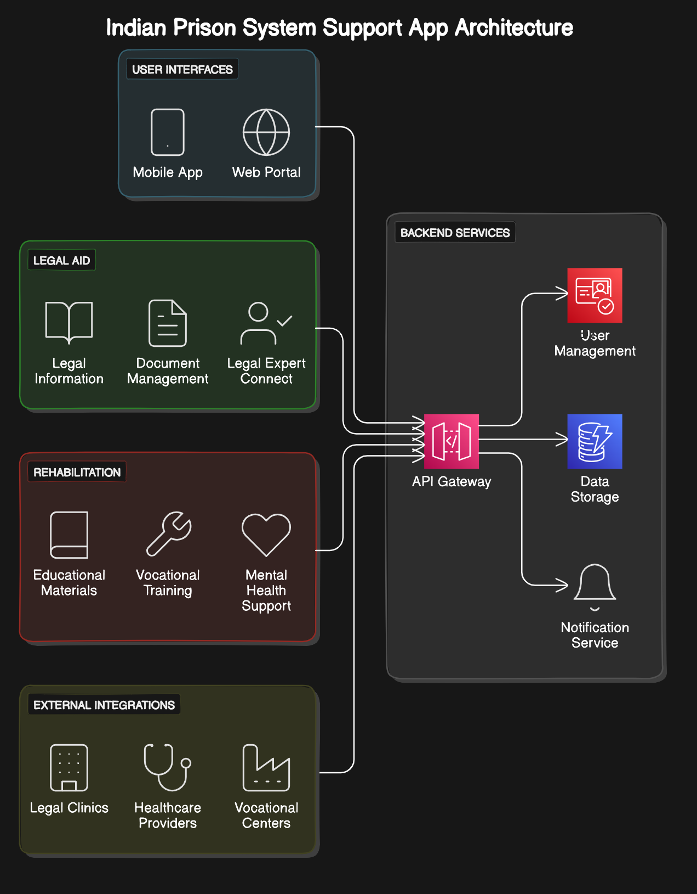
System Architecture

Slide 6
List of Modules
Legal Aid Module
Rehabilitation Module
Resource Access Module
Communication and Feedback Module
Monitoring and Evaluation Module

Slide 7
Functional Description for each modules
Legal Aid Module: The Legal Aid Module is designed to provide comprehensive legal support to undertrial prisoners. It connects users with legal experts and clinics, facilitating access to pro bono legal services. The module includes a secure communication platform for confidential consultations between prisoners and legal advisors. It offers detailed information on legal rights, court procedures, and case documentation management. Users can access a library of legal resources and FAQs to better understand their situations. The module also features tools for tracking case progress and receiving updates on court dates and legal proceedings. By integrating with legal aid organizations, it ensures timely and accurate legal assistance. The aim is to empower prisoners with the knowledge and support needed to navigate the legal system effectively.

Slide 8
Functional Description of Module
Rehabilitation Module:The Rehabilitation Services Module provides comprehensive support aimed at reintegrating undertrial prisoners into society. It includes educational materials covering various subjects to enhance literacy and knowledge. Vocational training programs equip prisoners with practical skills for employment opportunities post-release. The module also offers mental health support, providing access to counseling and therapy resources to address psychological needs. Progress tracking features help monitor individual advancement in educational and vocational activities. Collaboration with external training centers and mental health professionals ensures high-quality, tailored services. Additionally, the module facilitates workshops and seminars to promote personal development. Continuous updates and feedback mechanisms ensure the module remains relevant and effective in addressing rehabilitation needs.

Slide 9
Functional Description of Module
Resource Access Module: The Resource Access Module serves as a centralized repository for legal, social, and psychological support resources tailored to undertrial prisoners. It features a user-friendly interface, ensuring easy navigation and quick access to critical information. The module includes comprehensive legal resources, such as rights information, procedural guidelines, and document templates. Additionally, it provides educational materials, vocational training resources, and mental health support tools. Regular updates ensure the content remains accurate and relevant. The module facilitates secure access to various support services and allows prisoners to find information independently or with minimal assistance. By integrating diverse resources, the module aims to empower prisoners and enhance their self-sufficiency.

Slide 10
Functional Description of Module
Communication and Feedback Module: The Communication and Feedback Module is designed to facilitate secure and efficient interaction between undertrial prisoners and service providers. It includes encrypted messaging features for prisoners to communicate with legal advisors, rehabilitation experts, and support staff. This module enables real-time consultations and responses to urgent inquiries. Additionally, it provides structured feedback forms for prisoners to share their experiences, suggestions, and any issues encountered while using the app. The module ensures privacy and confidentiality of all communications and feedback. It also includes mechanisms for tracking and addressing reported issues promptly. By fostering open communication and continuous feedback, this module helps improve the app's services and responsiveness to user needs.

Slide 11
Functional Description of Module
Monitoring and Evaluation Module: The Monitoring and Evaluation Module is essential for assessing the effectiveness and efficiency of the mobile application. It tracks app usage metrics, including user engagement, frequency of access, and interaction with various services. This module employs data analytics to evaluate the impact of legal aid, rehabilitation services, and resource access on undertrial prisoners. It includes mechanisms for collecting user feedback and identifying areas for improvement. Regular reports and dashboards provide insights into app performance and user satisfaction. The module facilitates continuous improvement by integrating user feedback and adapting to evolving needs. It ensures that the app remains responsive, relevant, and effective in supporting undertrial prisoners. By monitoring outcomes and making data-driven adjustments, this module contributes to the overall success and sustainability of the project.

Slide 12
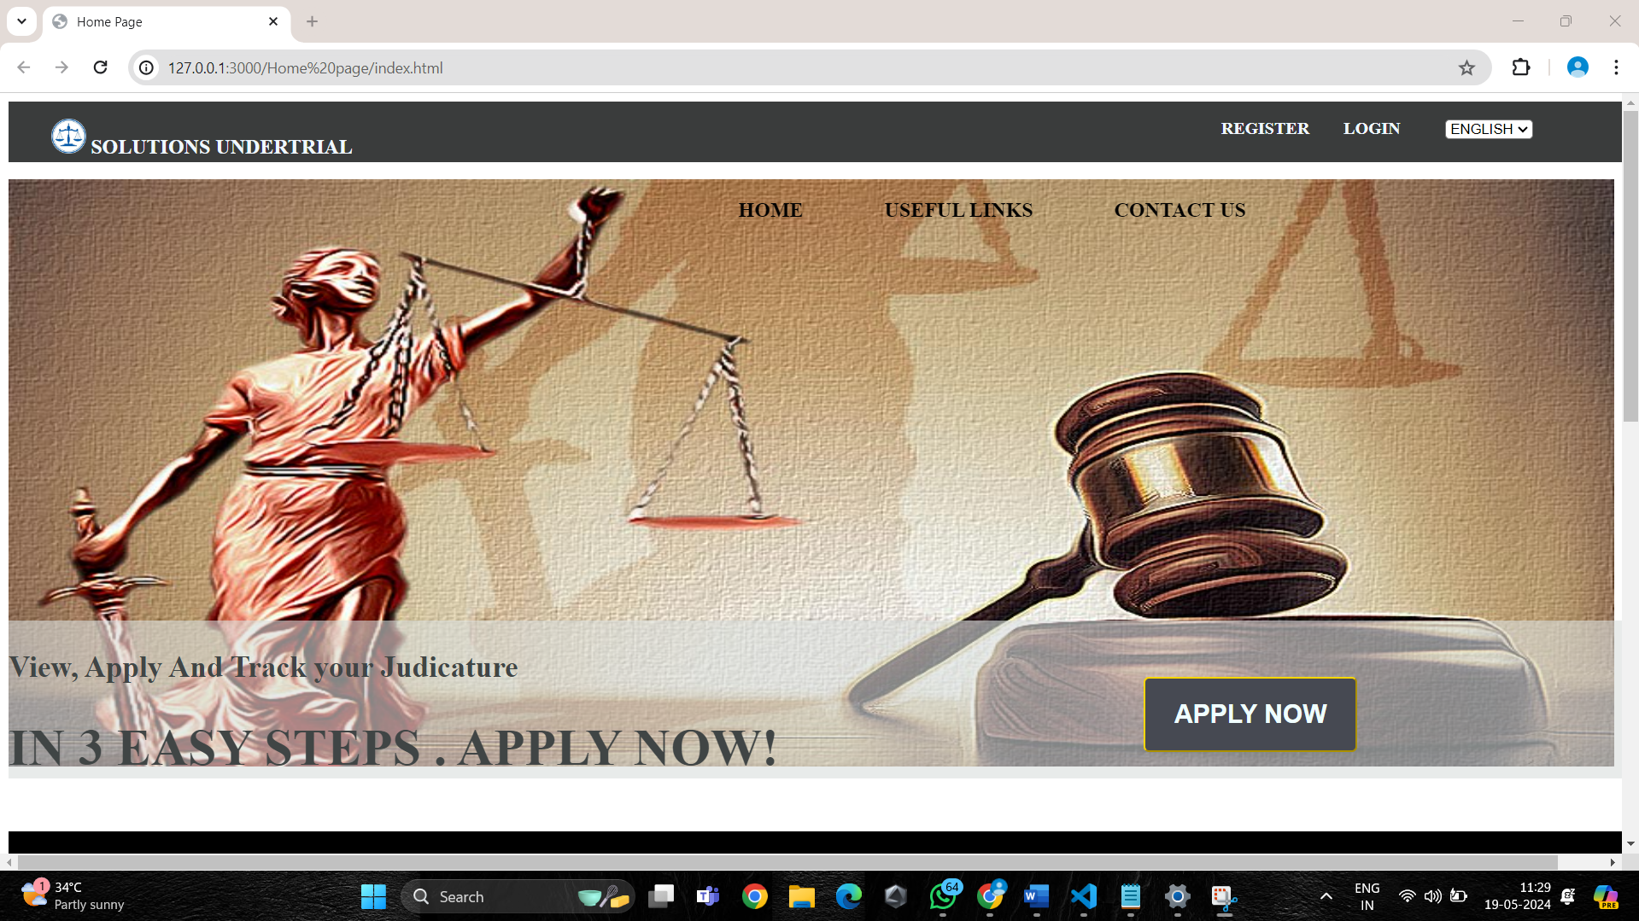
Output

Slide 13
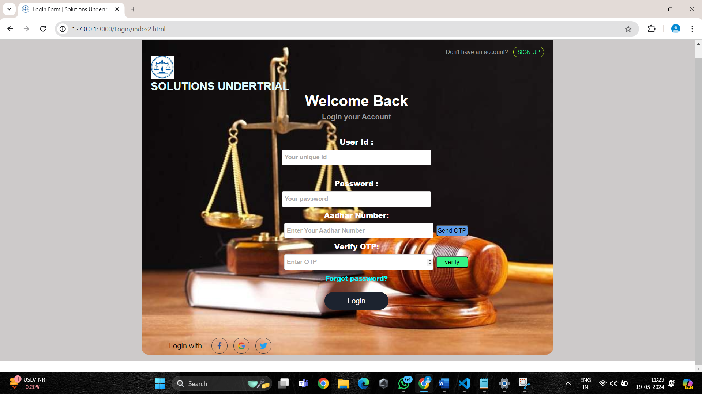
Output

Slide 14
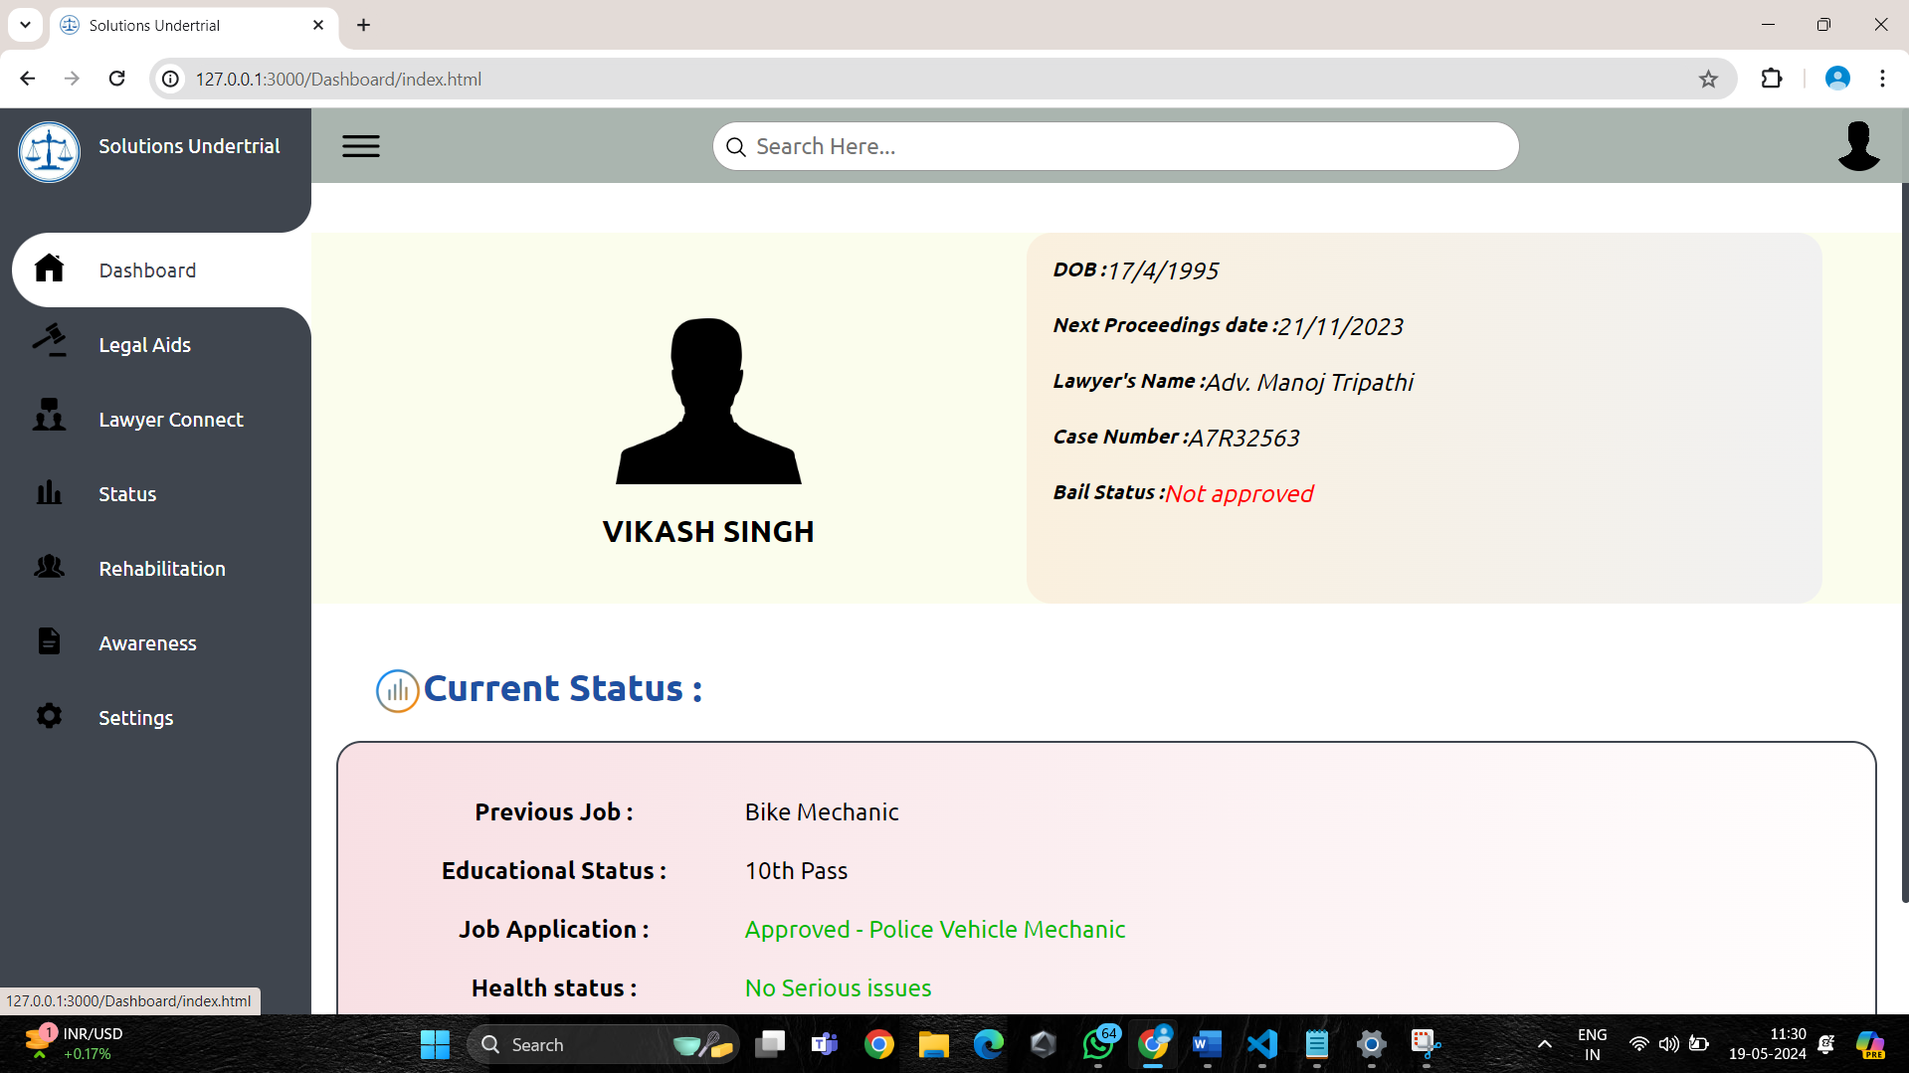
Output

Slide 15
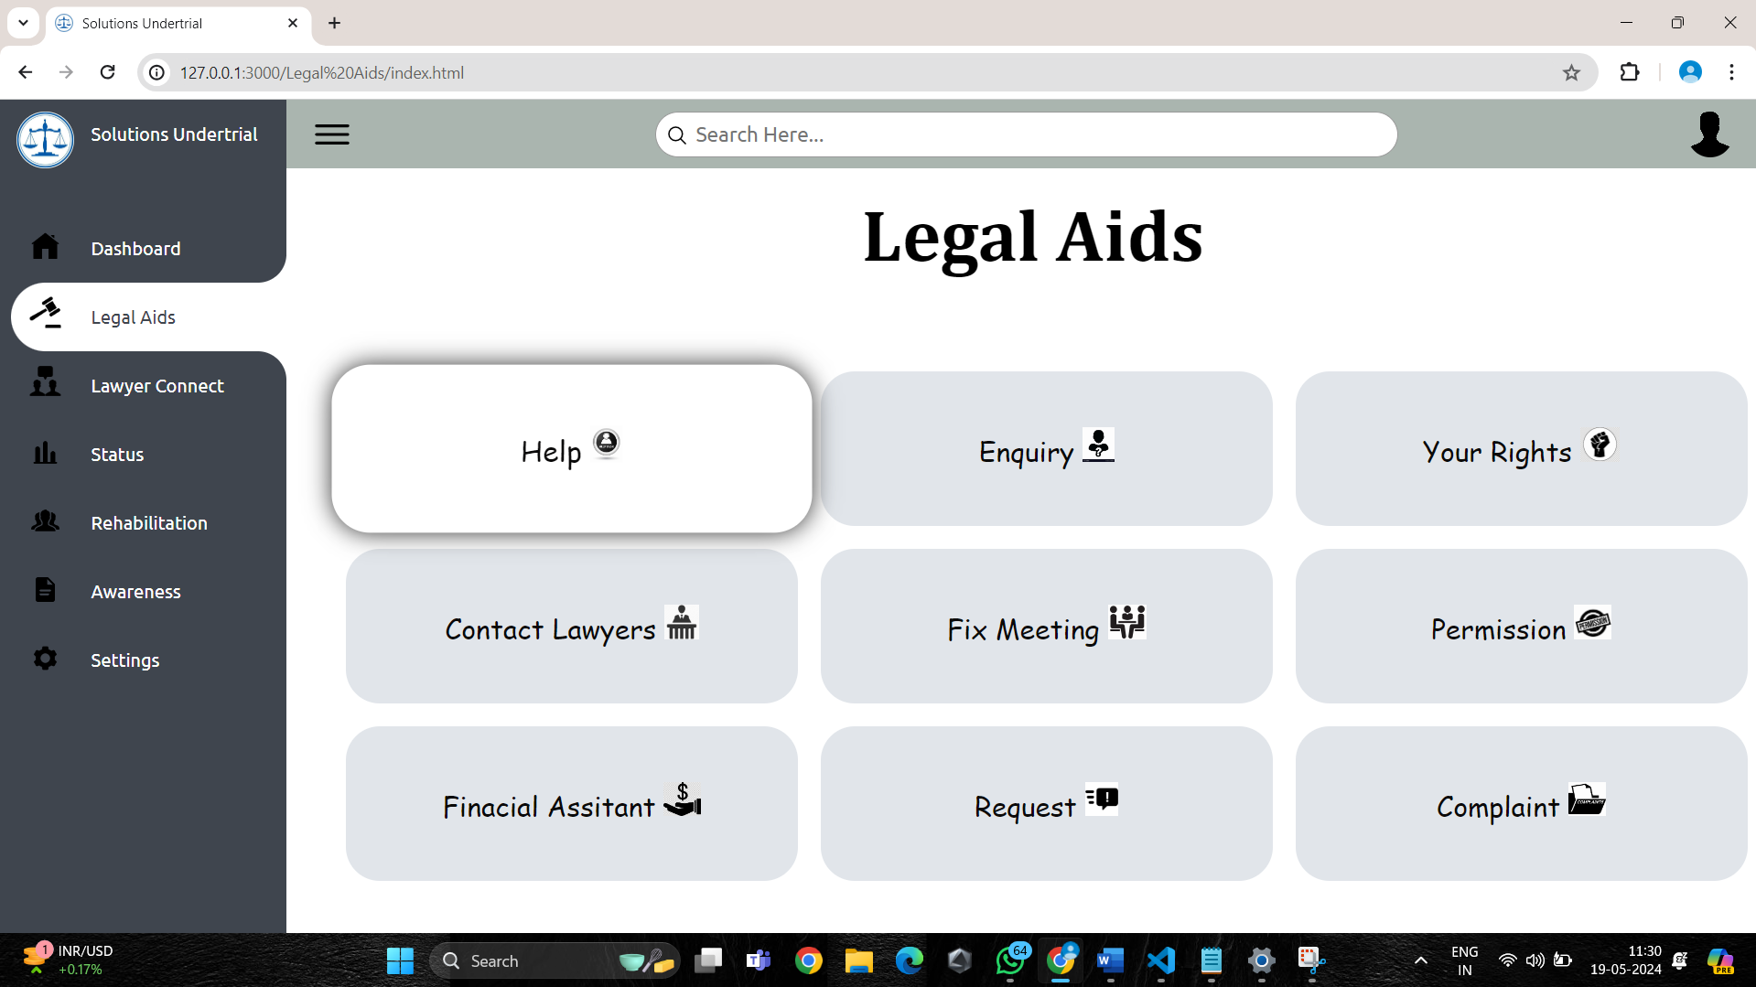
Output

Slide 16
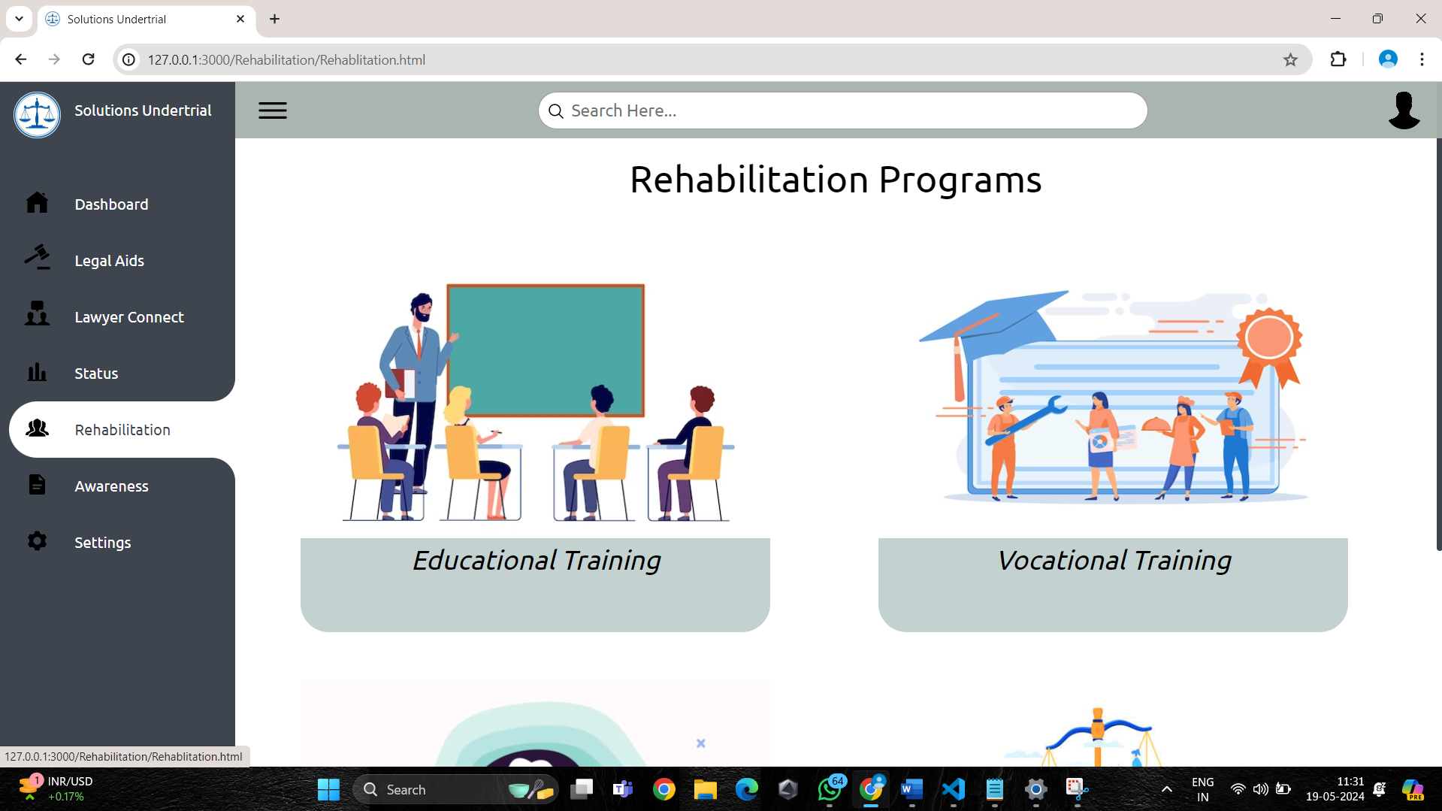
Output

Slide 17
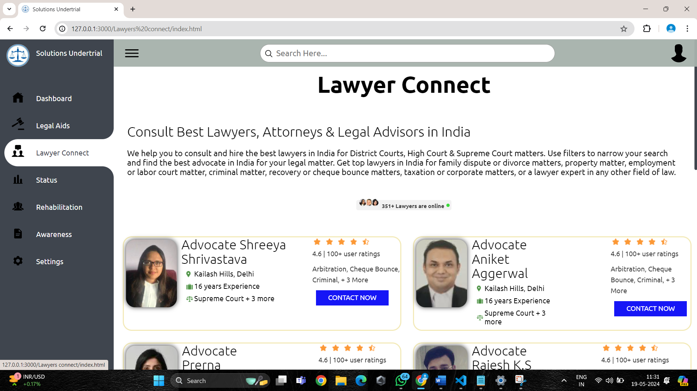
Output

Slide 18
Conclusion
In conclusion, the proposed mobile application represents a significant advancement in addressing the multifaceted needs of undertrial prisoners in India. By providing comprehensive legal aid, rehabilitation services, and resource access, the app aims to alleviate the challenges faced by this vulnerable population. Through secure communication channels and user-friendly interfaces, it empowers prisoners with essential information and support. Collaboration with legal aid organizations, healthcare providers, and vocational training centers ensures a holistic approach to prisoner well-being. Continuous monitoring and evaluation enable the app to adapt and improve based on user feedback and changing needs. This initiative not only promotes access to justice and rehabilitation but also contributes to broader criminal justice reforms and the upholding of human rights principles. Ultimately, the mobile application aspires to facilitate social integration and enhance the overall well-being of undertrial prisoners, fostering a more inclusive and humane prison system in India.

Slide 19
References
Ministry of Home Affairs, Government of India. (2020). Model Prison Manual for the Superintendence and Management of Prisons in India.
National Legal Services Authority (NALSA). (2021). Legal Aid Services for Undertrial Prisoners. Available at: http://nalsa.gov.in/services/legal-aid-to-undertrial-prisoners
World Health Organization (WHO). (2014). Prisons and Health. Available at: https://www.euro.who.int/__data/assets/pdf_file/0005/249188/Prisons-and-Health.pdf

Slide 20
Thank You

